Slide 1





THE INVISIBLE MAN

Slide 2

ABOUT THE AUTHOR
INTRODUCTION
CHARACTERS
CHAPTERS 1-28
CHARACTER ANALYSIS

Slide 3


About the Author
Herbert George Wells was born in 1866.
With a first-class degree in biology, he briefly became a teacher.

Slide 4


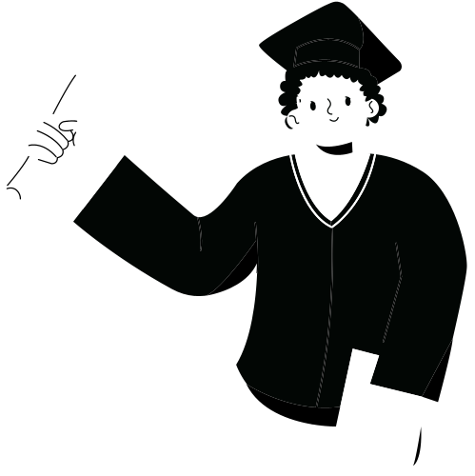
He lived on a small income from journalism and short stories.
Wells wrote with tremendous energy throughout his life, producing many science fiction stories.

Slide 5

Introduction
The Invisible Man is the story of a student.
He made 2 mistakes.
He came to Iping.
But his strange appearance made the people of Iping suspicious.

Slide 6




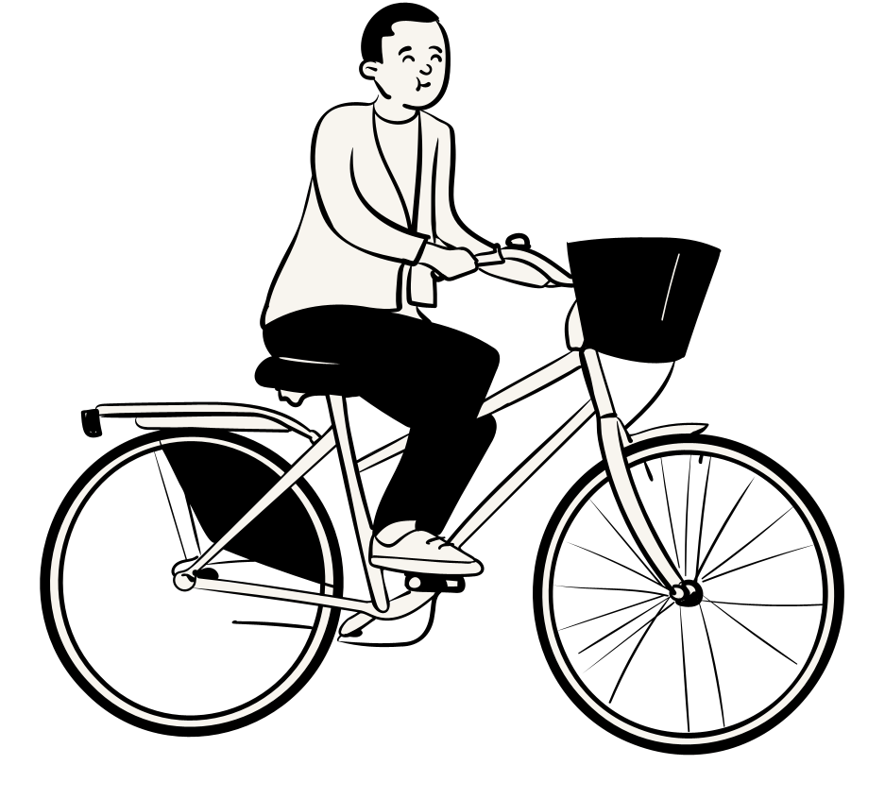

CHARACTERS

Slide 7
GRIFFIN: THE INVISIBLE MAN
MR. & MRS. HALL: OWNER OF THE ‘COACH & HORSES INN’
TEDDY HENFREY: A CLOCK JOBBER
THE REV. MR. BUNTING: A VICAR IN THE TOWN OF IPING
MARVEL: A LOCAL TRAMP

Slide 8

DR. KEMP: A SCIENTIST AND A FORMER ASSOCIATE OF GRIFFIN
DR. CUSS: A PHYSICIAN
MR. BOBBY JAFFERS: THE VILLAGE CONSTABLE
COLONEL ADYE: THE CHIEF OF BURDOCK POLICE

Slide 9


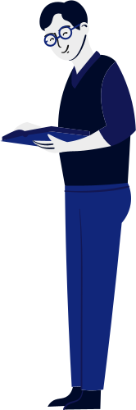






THANKYOU!!

